Slide 1


SAP CLOUD APPLICATION PROGRAMMING AND XSA TRAINING IN BPT
Anubhav Oberoy
Day – 10

Slide 2

Agenda – Day 10
Introduction to the Postman Tool
Performing CURD operation using the Postman
Introduction to Generic Handlers

Slide 3

Introduction to POSTMAN Tool
Postman is an API platform for building and using APIs. Postman simplifies each step of the API lifecycle and streamlines collaboration so you can create better APIs—faster.
It is an interactive and automatic tool for verifying the APIs of your project.
It presents you with a friendly GUI for constructing requests and reading responses. ... Postman is the way to streamline the process of API testing.
Postman can run GET, POST, PUT, PATCH, MERGE, DELETE, and various other request methods as well, and has utilities to help with developing APIs. Free and paid versions are available for Mac, Windows, Linux, and as a Chrome app.
You can Download the postman tool from the link give below:
https://www.postman.com/downloads/

Slide 4
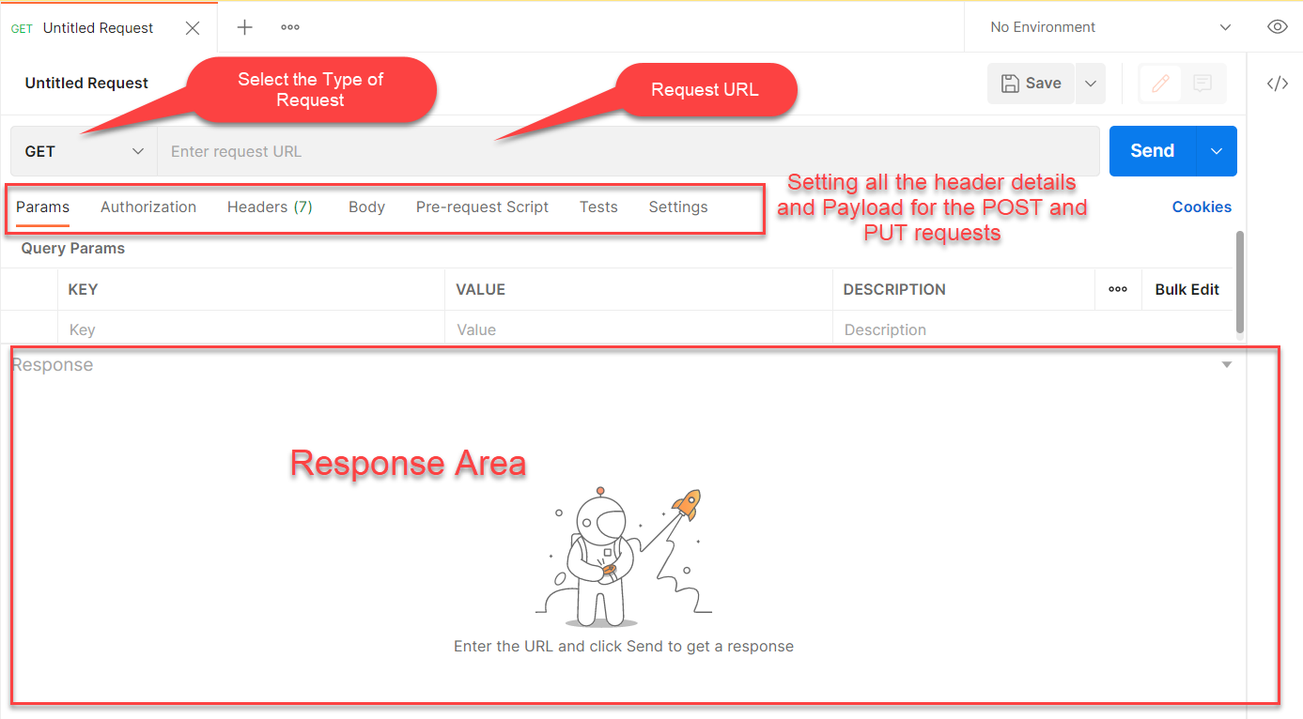
Postman App Layout
The below screen shot shows a basic layout of a request in Postman

Slide 5
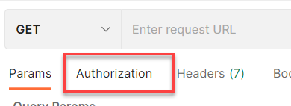
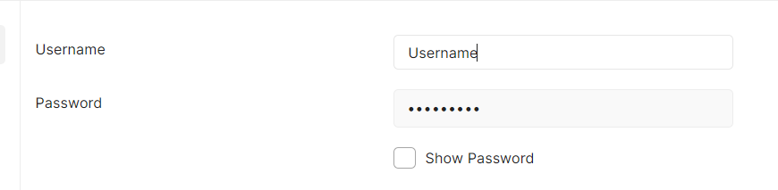
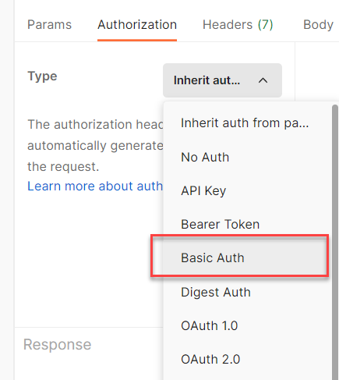
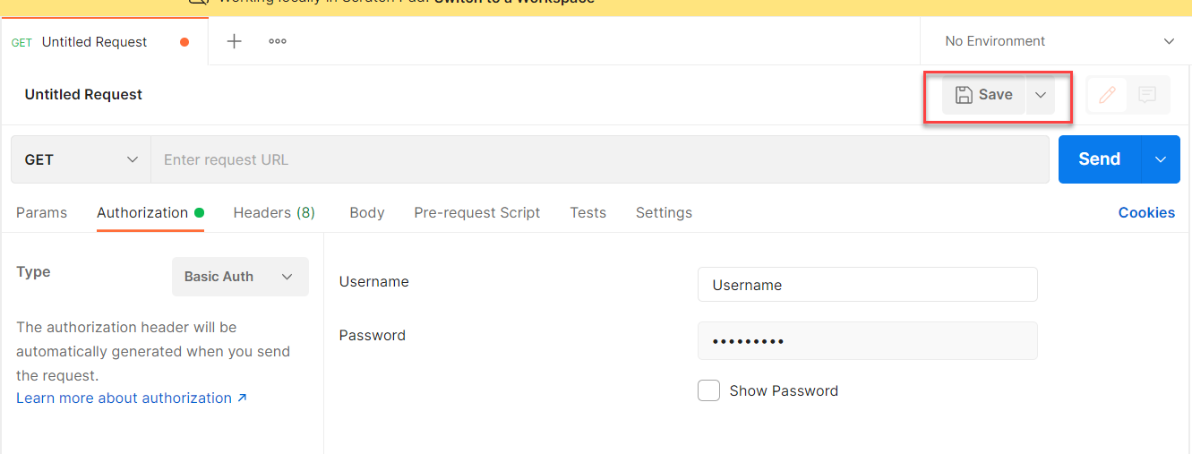
Setting Basic Auth in Postman
Step 1: Go to the Authorization section.
Step 3: Set the Username and Password.
Step 2: Select Basic Auth as Type
Step 4: Save.

Slide 6
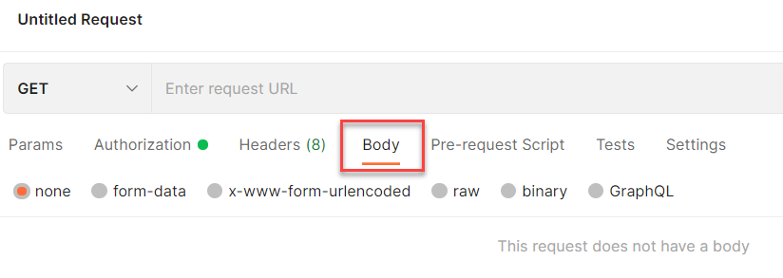
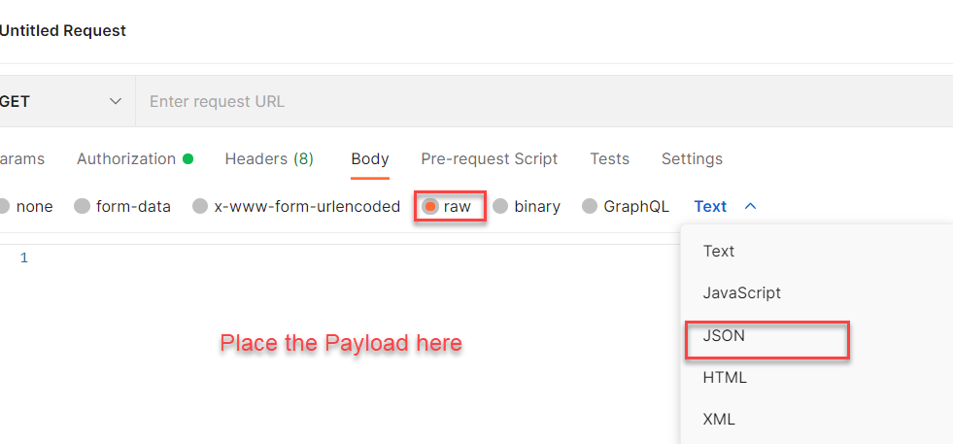
Setting the Payload for POST and PUT request
Step 1: Go to Body Section.
Step 2: Select the raw option form the radio button and then select the data type as JSON.

Slide 7
What is BTP?
Content

Slide 8
Title
Content

Slide 9
Title
Content

Slide 10

End of Day 10

Slide 11

Questions

Slide 12

Anubhav Oberoy

Slide 13


We’re committed to empower you to be
Most Desirable Resource
through powerful training solutions.
We build the workforce of the future.
250+
Corporate Clients
30,000+
Learners Trained
25000+
Learners Placed
FREE WEBINARS
Sign up for free webinars with industry experts every fortnight!
Enroll Now!
Contact us today!
https://anubhavtrainings.com/

Slide 14




More from AnubhavTrainings.com

Slide 15
Title
Content

